Slide 1


Session 4.1: Hybrid Search Implementations
Python Developers Transitioning into Full-Stack AI Application Developers

Slide 2
Session Agenda
1 The Semantic Blind Spot — When "Smart" AI fails at simple tasks.
2 Enter BM25 — Resurrecting the "Keyword King" of the 90s.
3 The Ensembling Problem — The math of adding miles to Celsius.
4 Reciprocal Rank Fusion — The great mathematical equalizer.
5 Hands-On Lab — Building the dual-engine architecture.

Slide 3





Course Objectives
Identify Blind Spots
Understand Mechanics
Implement Fusion
Recognize the "Exact Match" limitations inherent in Dense Vector (FAISS) architectures during critical searches.
Master the mathematics behind Sparse Vector retrieval, specifically focusing on the Okapi BM25 algorithm.
Build a LangChain EnsembleRetriever utilizing Reciprocal Rank Fusion (RRF) to normalize disparate results.

Slide 4
Part 1: The Keyword vs. Semantic Divide
Identifying the Blind Spots

Slide 5


The Tokenization Catastrophe
The Scenario: You desperately need details on Invoice #INV-2023-99X.
The Catastrophe:
•
The AI has no single pre-trained concept for that string.
•
It violently chops the ID: ["INV", "2023", "99", "X"].
•
It averages the meanings: "Invoice" + "Year 2023" + "Number 99".
The Analogy: It's like asking a librarian for a specific ISBN number, and they confidently hand you a totally different book from the same year because "it's conceptually similar."

Slide 6

The Vector Space Collision
Mathematical Blind Spot
To Cosine Similarity, entirely different invoices look identical because, conceptually, they are both just "invoices from 2023."
99.9%
False Semantic Match
The Result: The AI grabs INV-2023-99Y. The user pays the wrong vendor. The pipeline silently fails.

Slide 7


The Revenge of Sparse Search
The Legacy Savior
The "Vocabulary Gap" Flaw
When AI fails at exact matching, we resurrect Sparse Keyword Search.
But Sparse Search is incredibly brittle.
Example: You search for "puppy", but the document explicitly says "dog".
Think of it as the ultimate CTRL+F. It doesn't know what an invoice is, but it perfectly matches the literal text.
Because the exact letters p-u-p-p-y are missing, the system confidently returns zero results. It is completely blind to synonyms.
Match = Massive Score. No Match = Absolute Zero.

Slide 8






The Hybrid Mandate & Detective Analogy
FAISS (Dense Search)
BM25 (Sparse Search)
The Master AI Agent
The Behavioral Profiler: It understands motives, broad concepts, themes, and synonyms. Essential for semantic meaning.
The Fingerprint Analyst: It only cares about exact, microscopic, physical matches. Essential for unique identifiers.
You cannot build Enterprise AI with just one database. The Master Agent runs both detectives in parallel to solve complex queries.

Slide 9
Part 2: Enter BM25
The Keyword King

Slide 10


The Evolution of TF-IDF
Term Frequency (TF)
Inverse Document Frequency (IDF)
The Rule: The more a document mentions the keyword, the more relevant it is.
The Rule: Common words are penalized. Rare words are rewarded.
Example: A document saying "Budget" 10 times easily beats a document saying it once.
Example: In the search "The Budget", the word "The" is ignored completely. "Budget" holds all the mathematical weight.

Slide 11

The BM25 Breakthrough
Solving "Keyword Stuffing"
TF-IDF had a fatal flaw. Remember the SEO trick of 2005? Writing "Budget" 1,000 times in invisible white text sent your score to infinity.
Okapi BM25 fixes this with two brilliant limiters:
•
Saturation: Caps the repetition reward.
•
Length Normalization: Punishes rambling documents.
These two tweaks are why BM25 has powered enterprise search for 20 years.

Slide 12






Demystifying BM25 Hyperparameters
Raw Frequency: f(q_i, D)
The Spam Filter: k₁
The TL;DR Enforcer: b
Creates a strict ceiling. The first mention spikes the score. By the 10th mention, it flatlines. 10 mentions is not 10x better than 1.
Punishes long documents. A concise 50-word paragraph mentioning "Budget" will mathematically destroy a rambling 5,000-word essay.
The raw count of how many times the specific keyword physically appears in the document chunk.

Slide 13
Pause & Reflect
If BM25 is so perfect at finding exact strings, and solves the keyword-stuffing issue perfectly... why don't we just throw FAISS away and use BM25 for everything?
"
Because of the Vocabulary Gap. It is blind to synonyms.
"

Slide 14
Part 3: The Ensembling Problem
Apples and Oranges

Slide 15


Bounded vs. Unbounded Universes
FAISS: The Bounded Sandbox
BM25: The Unbounded Wild West
Cosine Similarity is perfectly normalized. It exists on a strict, predictable scale.
BM25 is an ever-growing probabilistic summation. It has absolutely no ceiling.
Real-world scores almost always hover tightly between 0.70 and 0.95.
A rare keyword string might hit 45.8 or easily surpass 150.0+.
The Dilemma: How do you add 5 miles to 30 degrees Celsius?

Slide 16
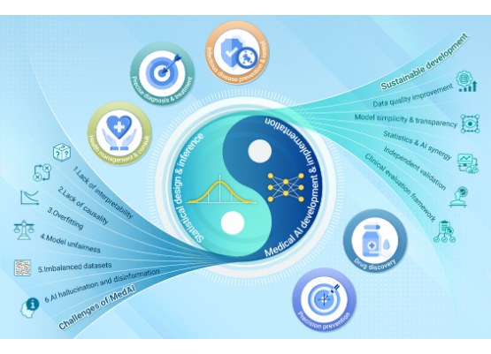
The Catastrophe of Linear Combination
The Junior Developer Approach: Let's just add them together!
•
Doc A (Perfect Semantic Match):
FAISS 0.88 + BM25 0.0 = 0.44
•
Doc B (Random IT Ticket):
FAISS 0.40 + BM25 12.5 = 6.45
The Result: BM25's massive integer scale completely swallows the tiny decimal output of the FAISS engine. Semantic meaning is entirely destroyed.

Slide 17
The Min-Max Normalization Trap
Why Normalization Fails
0.02
"Let's just normalize BM25 to a 0-1 scale!"
The Skew Reality: Imagine grading a class on a curve where one student somehow scores 5000%.
If an outlier document scores 80.0, scaling against it crushes 99 perfectly valid documents into microscopic decimals. The ensemble fails again.
Crushed Score

Slide 18
Part 4: Reciprocal Rank Fusion
The Great Equalizer

Slide 19


The Mathematics of RRF
The Paradigm Shift
The RRF Equation
We can't add them. We can't weight them. We can't normalize them.
Calculates a unified score based strictly on the inverse of a document's positional rank.
The Secret: Stop looking at the scores entirely. Look at the podium.
The only universal truth between the algorithms is Positional Rank.

Slide 20
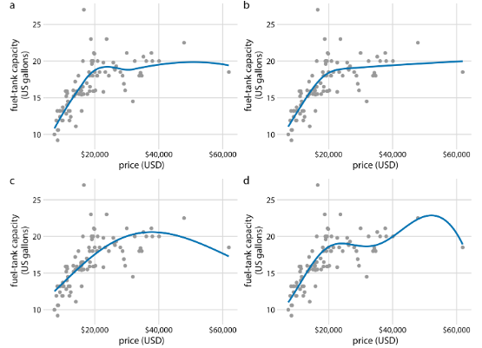
The Magic of the 'k' Constant
Flattening the Curve
In industry, k is almost always hardcoded to 60. Why?
If k=0, the #1 spot gets a massive 1.0 score. The Gold Medalist becomes a dictator, destroying consensus.
By adding 60, we flatten the output:
•
Rank 1: 1 / (60 + 1) = 0.0163
•
Rank 2: 1 / (60 + 2) = 0.0161
The Result: It heavily rewards consensus over a single lucky spike.

Slide 21
The RRF Simulation
Document (Query: Q4 Revenue Project Alpha) | FAISS Rank | BM25 Rank | RRF Calculation (k=60)
A: Pure Semantic Match (Mentions "income pushbacks") | #1 | Not Found | (1/61) + 0 = 0.01639
B: Pure Keyword Match (Irrelevant IT ticket with terms) | #25 | #1 | (1/85) + (1/61) = 0.02815
C: True Hybrid Match (Financial report: Q4 Alpha income) | #3 | #4 | (1/63) + (1/64) = 0.03149

Slide 22
The RRF Victory
The Decathlon Athlete
#1
Notice that Document C did not win gold in either individual database!
The Lesson: Like a decathlon athlete, it didn't win every specific event, but its high overall consensus mathematically proved it was the most well-rounded answer.
Consensus Winner

Slide 23


The LangChain Abstraction
EnsembleRetriever
Under the Hood
As Senior Engineers, we understand the brutal math so we can debug the pipeline when things burn down.
You pass it a FAISS and BM25 retriever, and it automatically:
•
Runs parallel async searches.
But for production? We rely on LangChain's beautifully abstracted EnsembleRetriever.
•
Strips out the wildly incompatible raw scores.
•
Applies the k=60 RRF calculus to return the unified list.

Slide 24
Part 5: Hands-On Lab
Building the Hybrid Pipeline Architecture

Slide 25






Lab Step 1 & 2: Setup and Dataset
Upgrade Dependencies
Construct Executive Dataset
Intentional Sabotage
Install the necessary statistical libraries (rank_bm25) alongside standard vector packages (LangChain, FAISS) to enable local CPU-based sparse mathematics.
Ensure your dataset is designed to intentionally test the dense engine's blind spots using overlapping contextual vocabulary.
Initialize secure API authentication. Create a miniature business dataset containing exact keyword "needles" alongside semantic "distractors".

Slide 26






Lab Step 3 & 4: Dual Engines and Fusion
Initialize Dual Engines
Reciprocal Rank Fusion
Execution Stress Test
Spin up the Semantic Profiler by embedding documents into FAISS. Spin up the Fingerprint Analyst by building a local BM25 statistical index.
Wrap both retrievers inside LangChain's EnsembleRetriever class, ensuring weights are balanced to allow RRF to take over.
Execute a complex query requiring both conceptual understanding and an exact ID match. Observe the ensemble returning the perfect hybrid result.

Slide 27
The Pinnacle of Retrieval
Hybrid Search outputs are still just a "Net". The final step relies on a Cross-Encoder for neural evaluation.
Questions on Hybrid Architectures or RRF Mathematics?

